Slide 1


Competency Assessment Report
Name:
ahlem masouad
Target Position:
Senior Project Manger
July 31, 2025

Slide 2
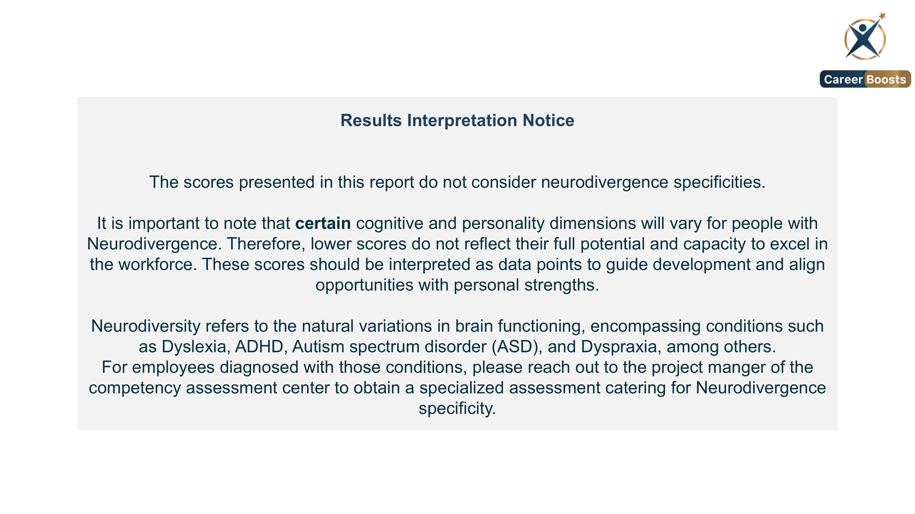
2

Slide 3
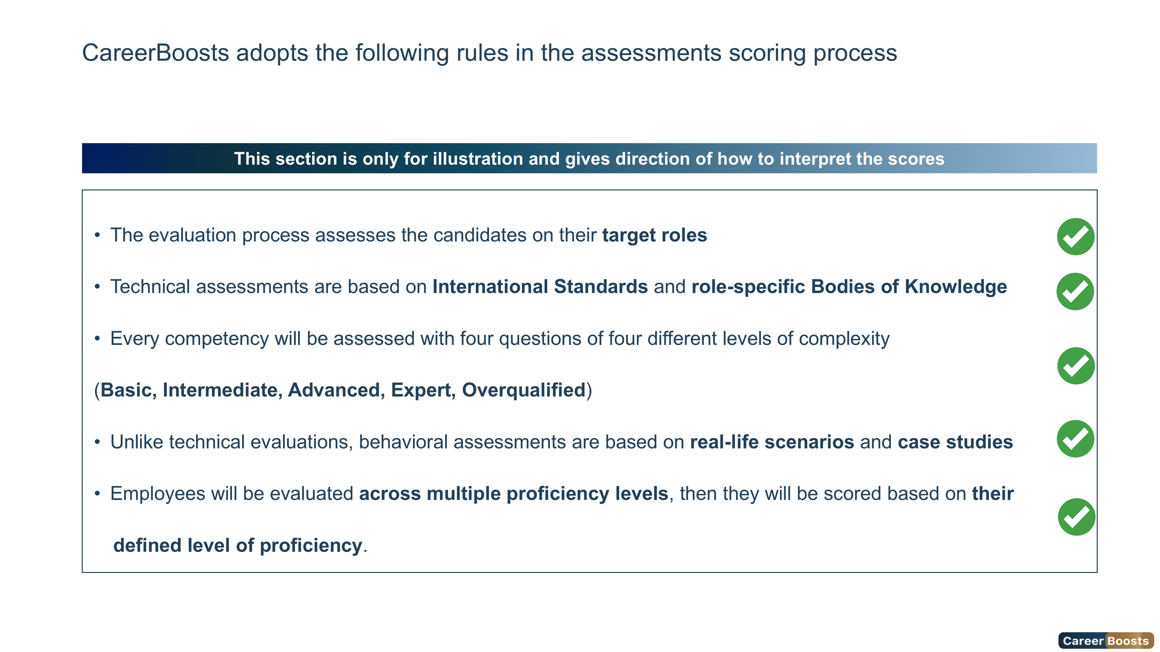
3

Slide 4
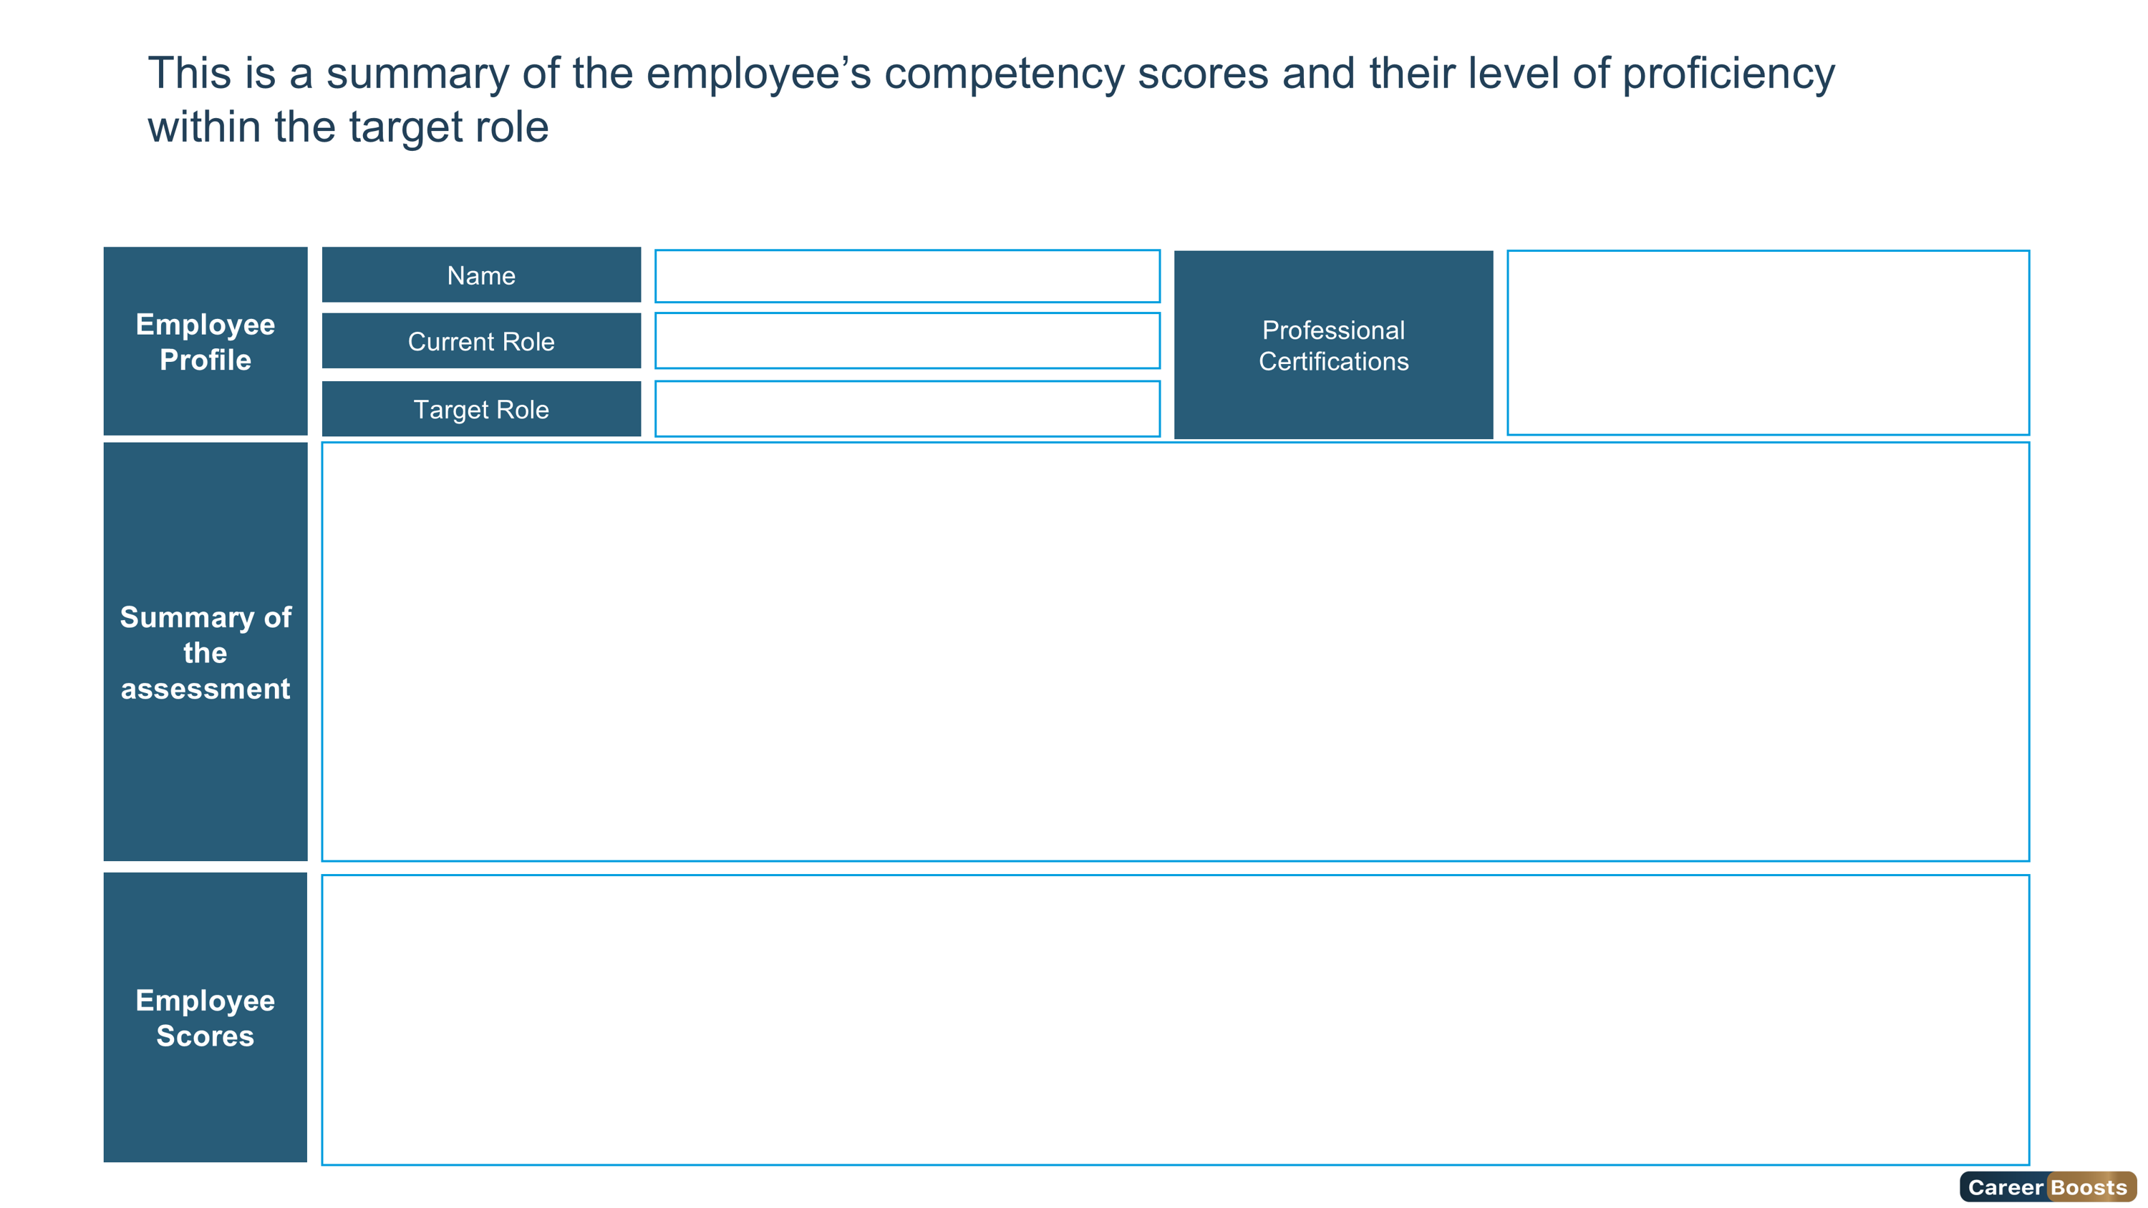



Foundation
Intermediate
Advanced
Expert
Overqualified
Ms. ahlem masouad
Information not provided
Junior Project Manger
Senior Project Manger
Ms. ahlem masouad has secured the Advanced level of the Senior Project Manger role.
She was evaluated on technical competencies such as “Risk Management and Business Continuity”, “Strategy Formulation, Implementation and Planning”, as well as “Talent Acquisition”, scoring 89% within the Expert level. Ms. ahlem masouad was assessed on Leadership competencies such as, “Financial Acumen”, “Decision Making”, as well as “Strategic Mindset”, scoring 73% within the Advanced level. She was assessed on behavioral competencies such as “Behavioral for Business”, “Behavioral for Business2”, as well as “Behavioral for Business3”, scoring 93% within the Expert level. Ms. ahlem has obtained a score of 80% in Hogan Personality Inventory (HPI), and 86% in Hogan Business Reasoning Inventory (HBRI). Based on the HBRI score, She has a cognitive style of a Contextual Thinker. Considering all scores, Ms. ahlem masouad has achieved an overall score of 54% ,reflecting High performance and High potential, they have been assigned to the Outstanding Leader category in the nine-box matrix. This classification indicates their exceptional performance and their significant potential to contribute to the organization's success.
To further elevate her skills and achieve the Expert Level, She should accomplish the recommended individual development plan.
Overall Score
Leadership Score
Technical Score
Behavioral Score
Cognitive Score
Personality Score
54%
73%
89%
93%
86%
80%
4

Slide 5
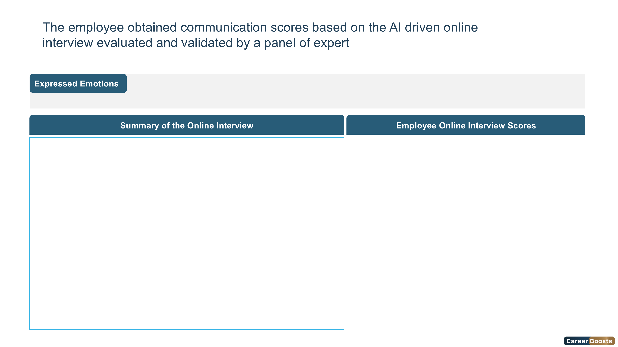


Joy
Surprise
Neutral
Sad
Fear
Angry
Disgust
Ms. ahlem masouad achieved a score of 81% in Message Relevance, demonstrating a generally good focus on delivering information relevant to the questions asked, with occasional instances where responses could have been more focused or directly aligned with the questions. For Pitch Volume, Ms. Maitha scored 62% showcasing a well-modulated volume that made the participant's communication easy to follow, maintaining clarity throughout the conversation. In Pronunciation, she received a score of 79%, demonstrating clear and accurate enunciation, contributing to a strong and easily understood delivery. In Posture, Ms. Maitha scored 99%, reflecting a confident and professional physical presence during the interview, which positively contributed to the participant's overall impression and engagement. For Articulation, she achieved a score of 89%, demonstrating clear and precise articulation, contributing to a confident and easily understood delivery. Based on her performance across these dimensions, Ms. Maitha Al Falasi achieved an Overall Communication Quality score of 85%. This score indicates outstanding communication skills.
5

Slide 6
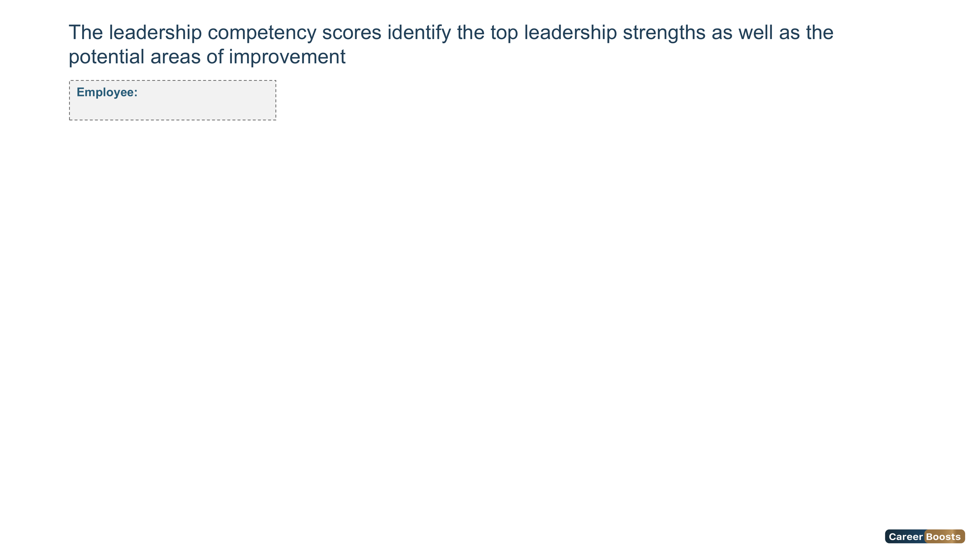
Foundation
Intermediate
Advanced
Expert
Overqualified
Ms. ahlem masouad
Leadership Competencies Scores
6

Slide 7
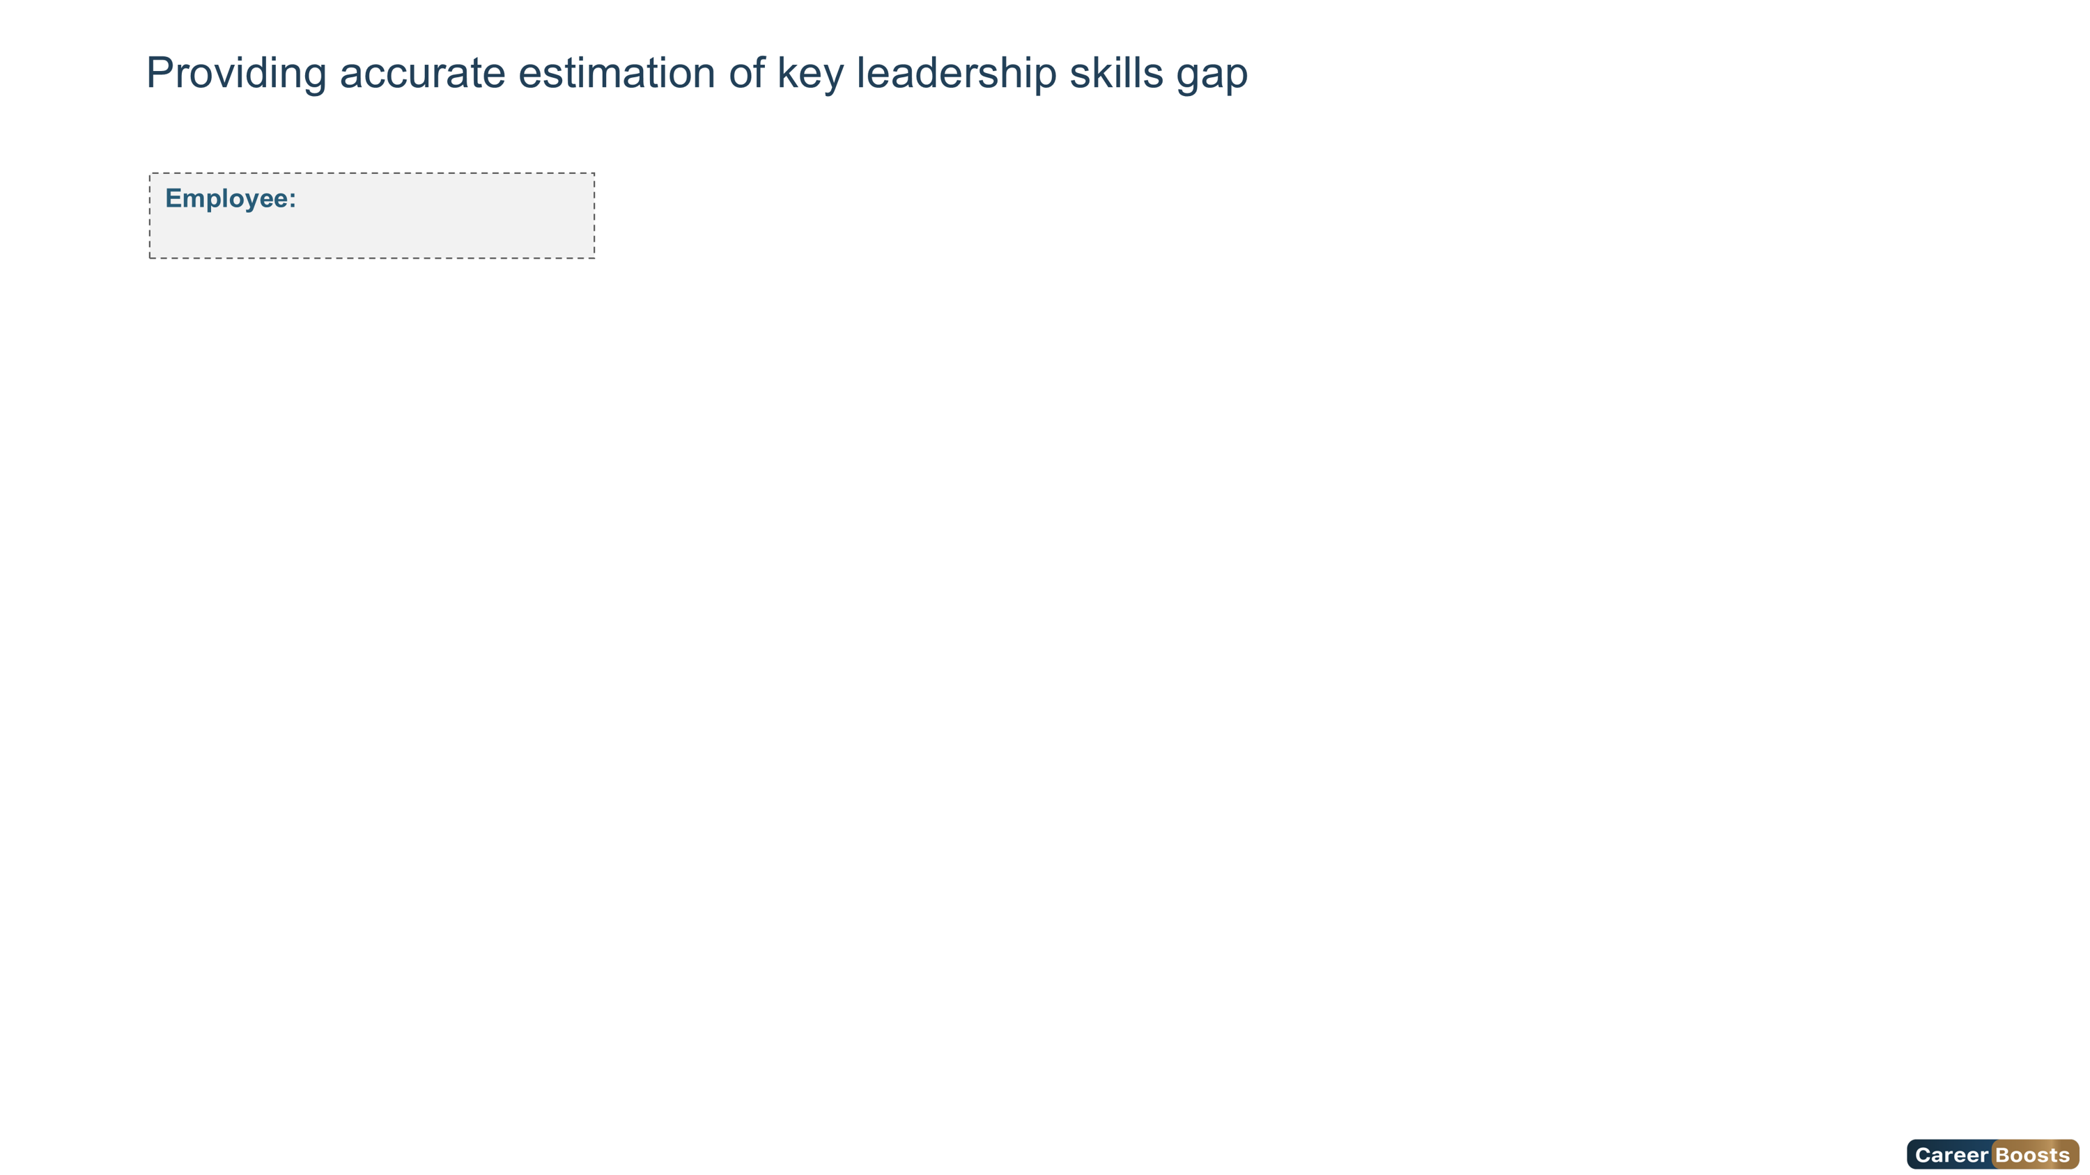
Foundation
Intermediate
Advanced
Expert
Overqualified
Ms. ahlem masouad
7

Slide 8
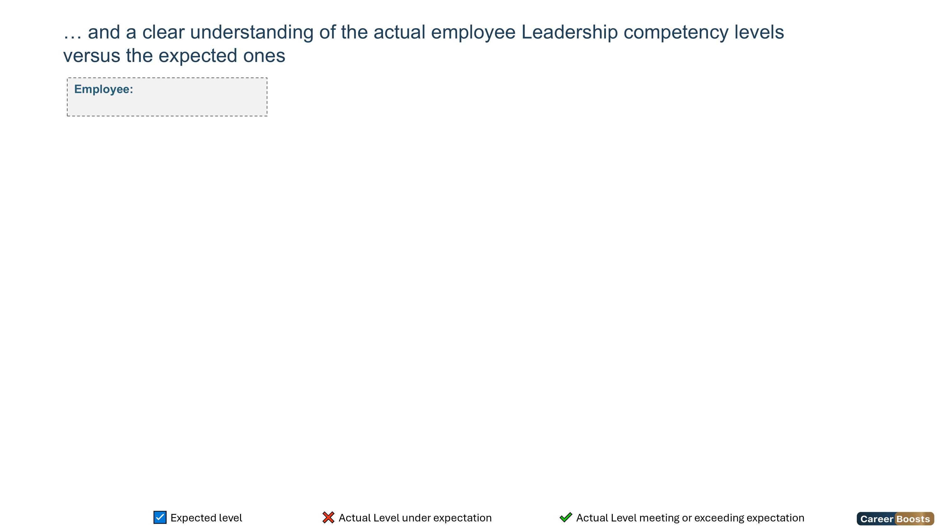
Foundation
Intermediate
Advanced
Expert
Overqualified
Ms. ahlem masouad
Competency Name | Foundation | Intermediate | Advanced | Expert | Overqualified
Financial Acumen | ❌ |  |  | ☑️
Decision Making | ❌ |  | ☑️
Strategic Mindset |  | ❌ | ☑️
Business Insight |  | ❌ | ☑️
Building Effective Teams |  | ❌ | ☑️
8

Slide 9
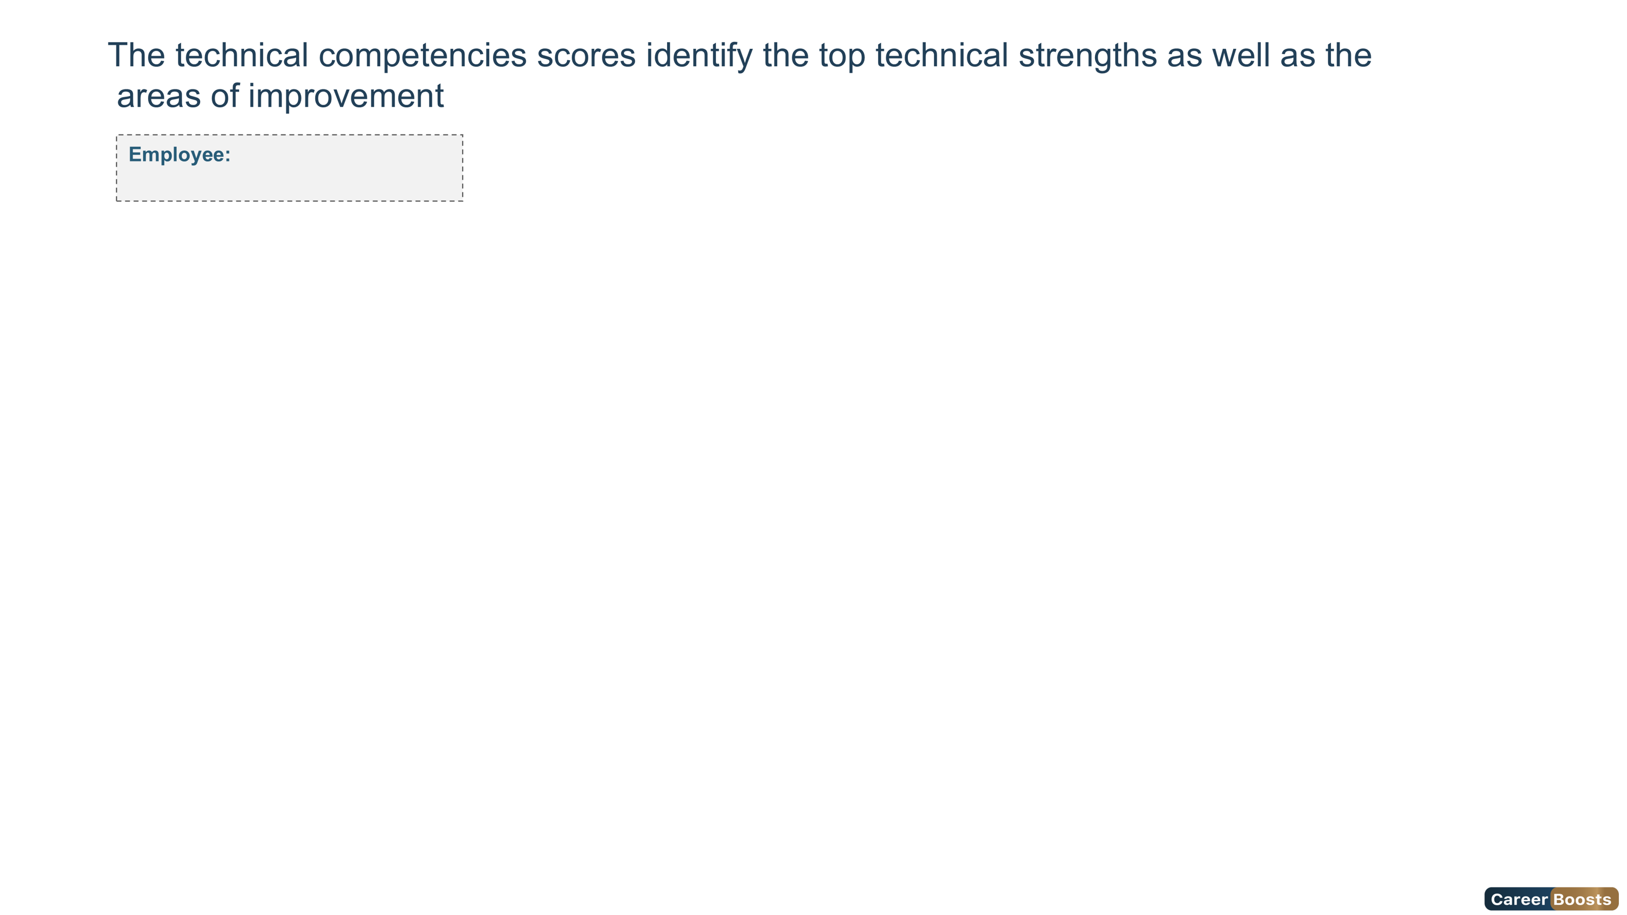
Foundation
Intermediate
Advanced
Expert
Overqualified
Ms. ahlem masouad
Technical Competencies Scores
9

Slide 10
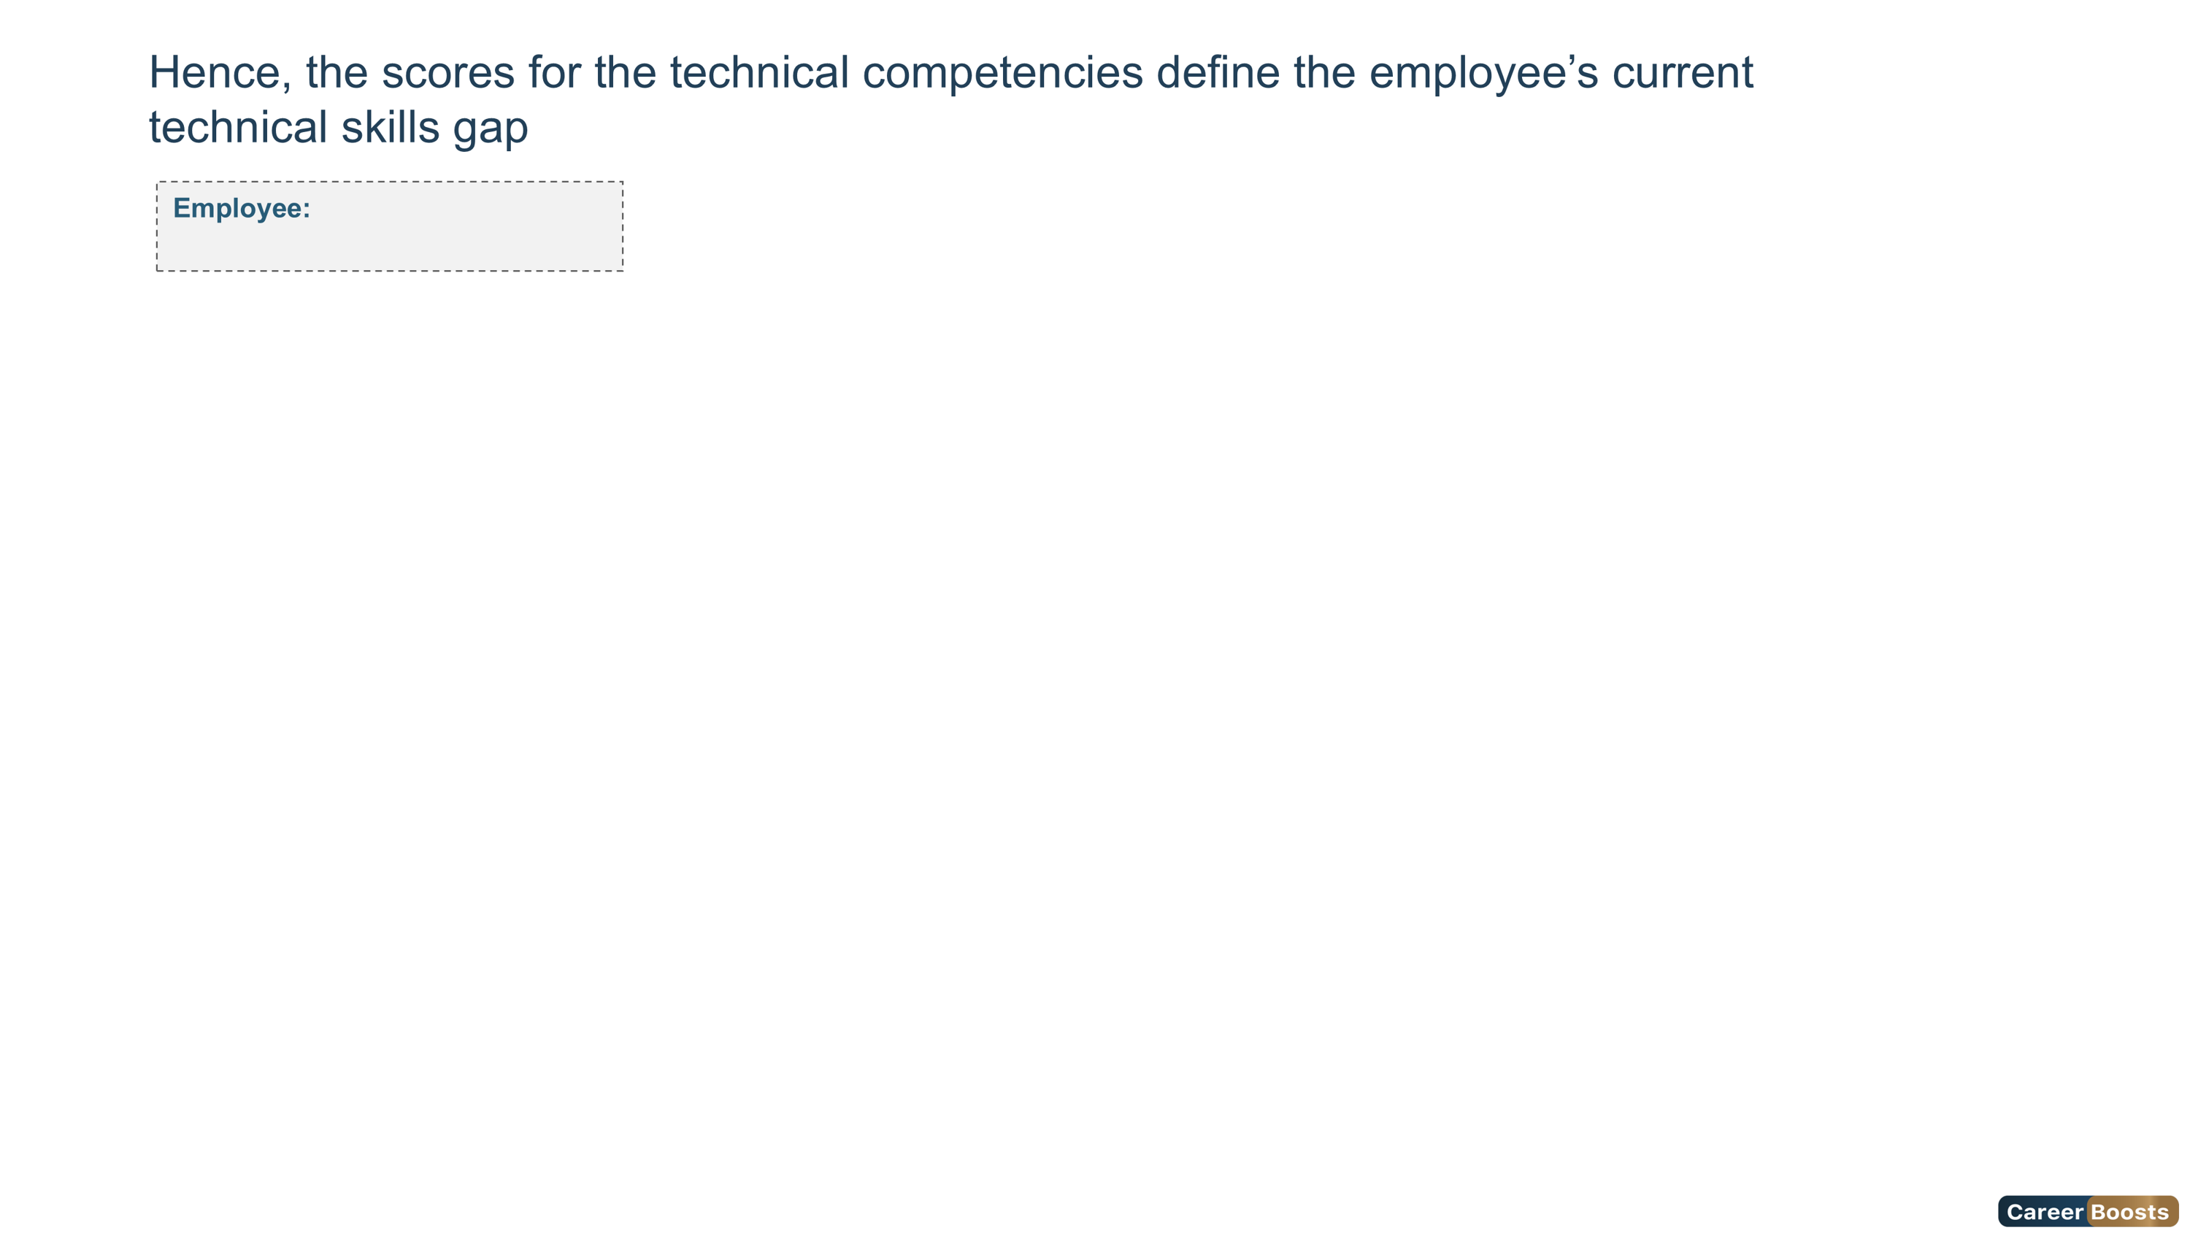
Foundation
Intermediate
Advanced
Expert
Overqualified
Ms. ahlem masouad
10

Slide 11

Foundation
Intermediate
Advanced
Expert
Overqualified
Ms. ahlem masouad
Competency Name | Foundation | Intermediate | Advanced | Expert | Overqualified
Risk Management and Business Continuity |  |  | ✔️ ☑️
Strategy Formulation, Implementation and Planning |  |  | ✔️ ☑️
Talent Acquisition | ❌ |  | ☑️
Project Management |  |  | ✔️ ☑️
Budgeting and Financial Management |  |  | ✔️ ☑️
Organizational Development |  |  | ☑️ | ✔️
11

Slide 12
Foundation
Intermediate
Advanced
Expert
Overqualified
Ms. ahlem masouad
Competency Name | Foundation | Intermediate | Advanced | Expert | Overqualified
Employee Relations Management | ❌ |  | ☑️
Talent Management |  | ❌ | ☑️
Policies, Systems, Processes and Procedures Implementation |  |  | ❌ | ☑️
Compensation and Benefits Management | ❌ |  |  | ☑️
Performance Management |  |  | ❌ | ☑️
Stakeholders Management | ❌ |  |  | ☑️
12

Slide 13
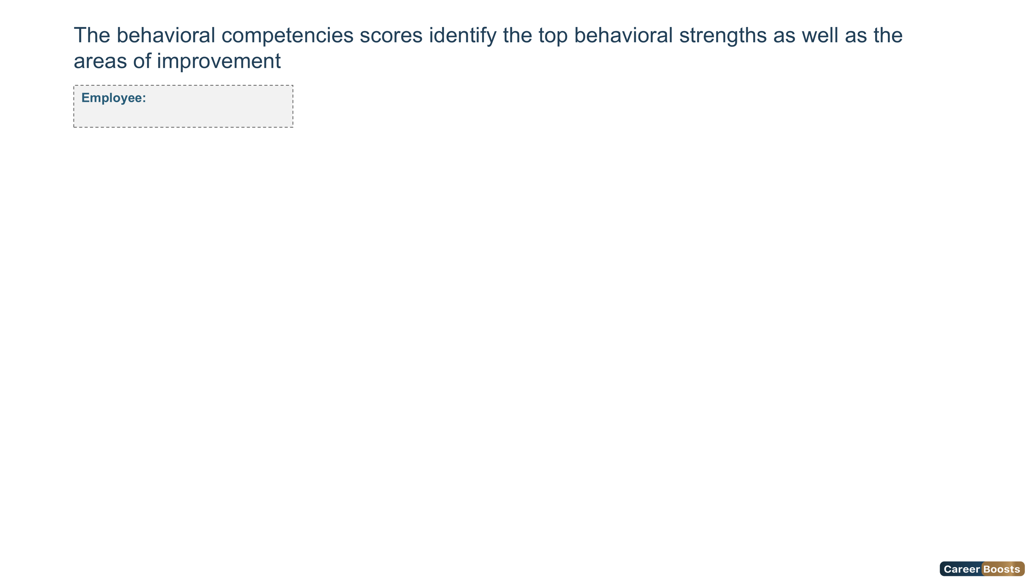
Foundation
Intermediate
Advanced
Expert
Overqualified
Ms. ahlem masouad
Behavioral Competencies Scores
13

Slide 14

Foundation
Intermediate
Advanced
Expert
Overqualified
Ms. ahlem masouad
14

Slide 15

Foundation
Intermediate
Advanced
Expert
Overqualified
Ms. ahlem masouad
Competency Name | Foundation | Intermediate | Advanced | Expert | Overqualified
Behavioral for Business | ❌ | ☑️
Behavioral for Business2 |  | ✔️ ☑️
Behavioral for Business3 |  | ☑️ | ✔️
Behavioral for Business4 | ❌ | ☑️
15

Slide 16
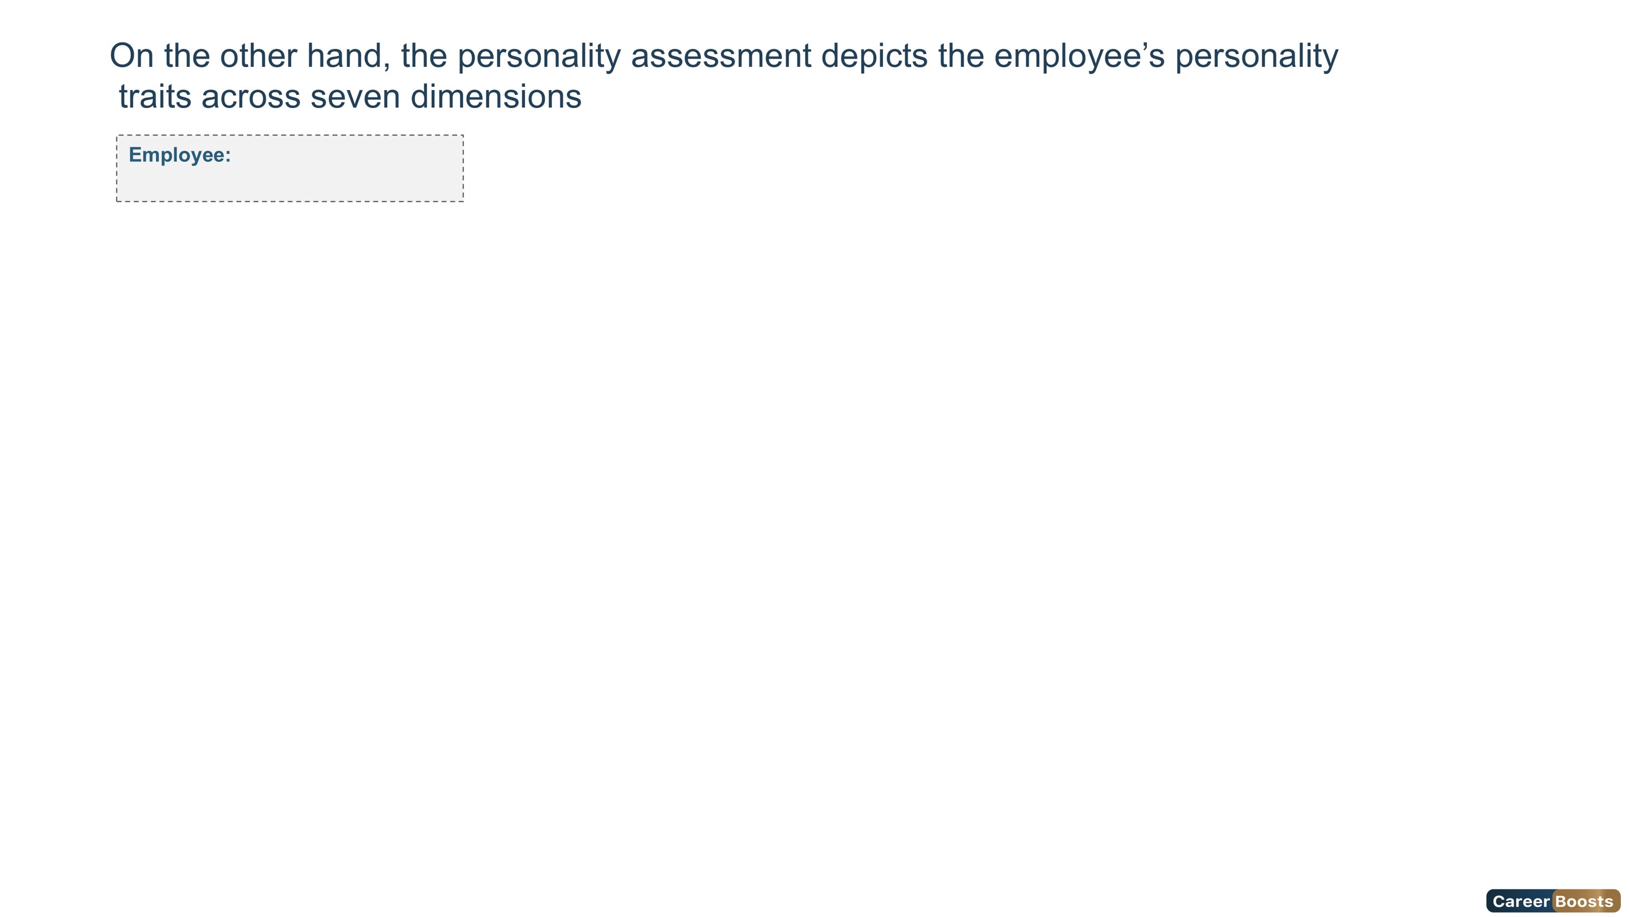
Ms. ahlem masouad
HPI - Personality Scale
16

Slide 17
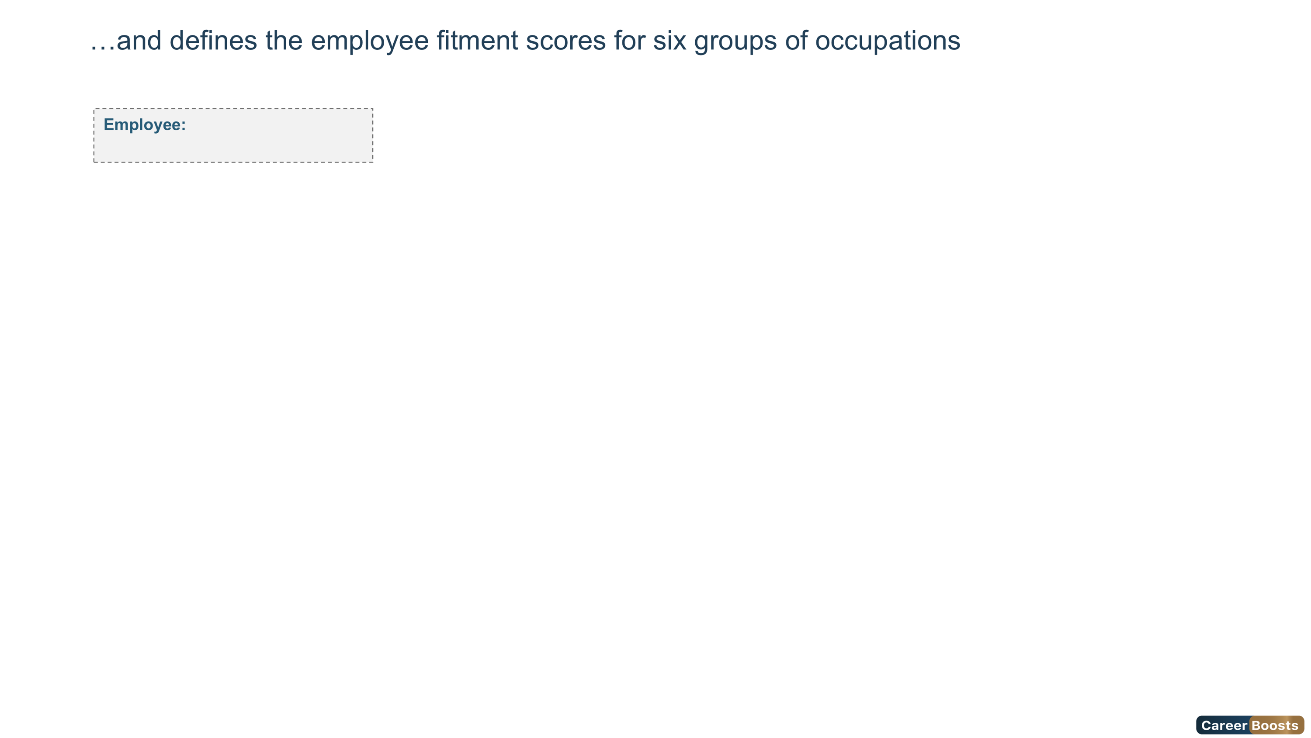
Ms. ahlem masouad
HPI - Professional Scale
96%
98%
96%
95%
64%
90%
Managerial Potential
Stress Tolerance
Service Orientation
Clerical Potential
Sales Potential
Reliability
17

Slide 18
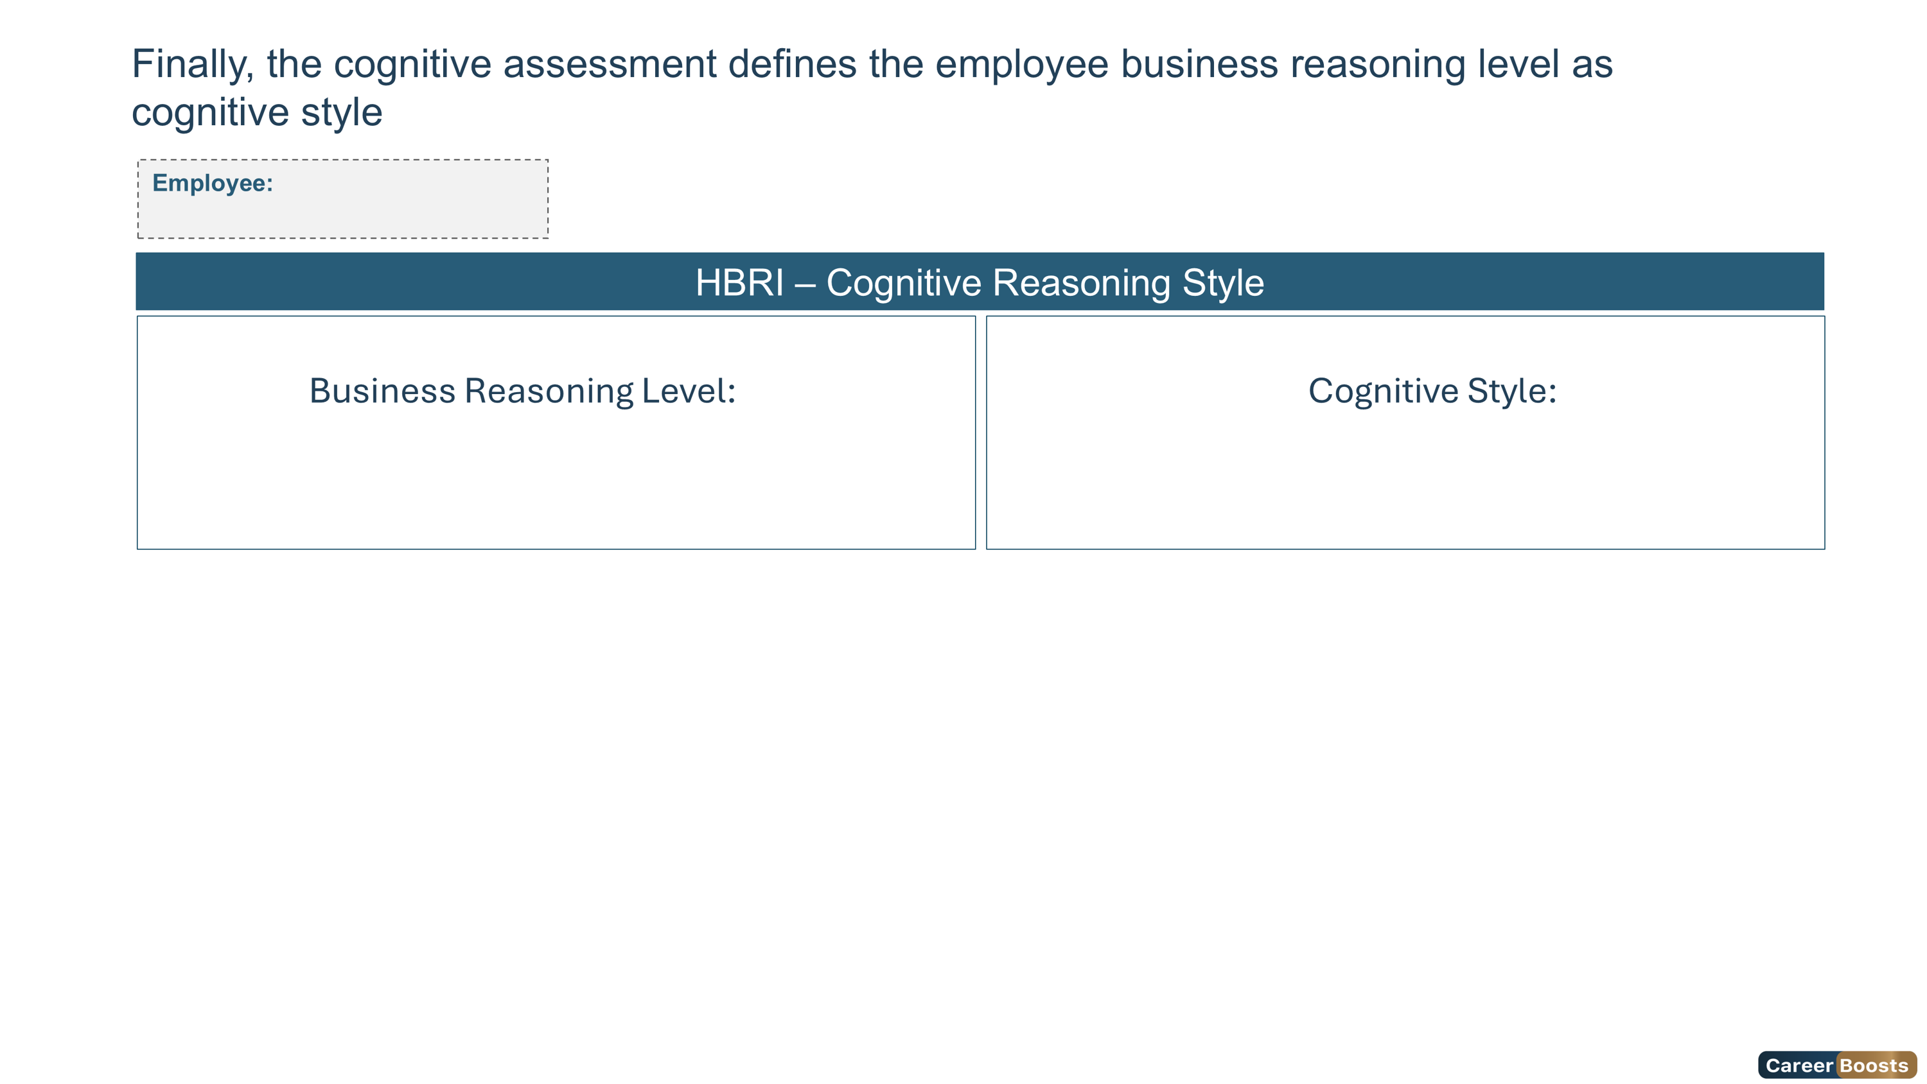
Ms. ahlem masouad
Low
Contextual
100%
83%
75%
Quantitative Reasoning
Business Reasoning
Qualitative Reasoning
18

Slide 19
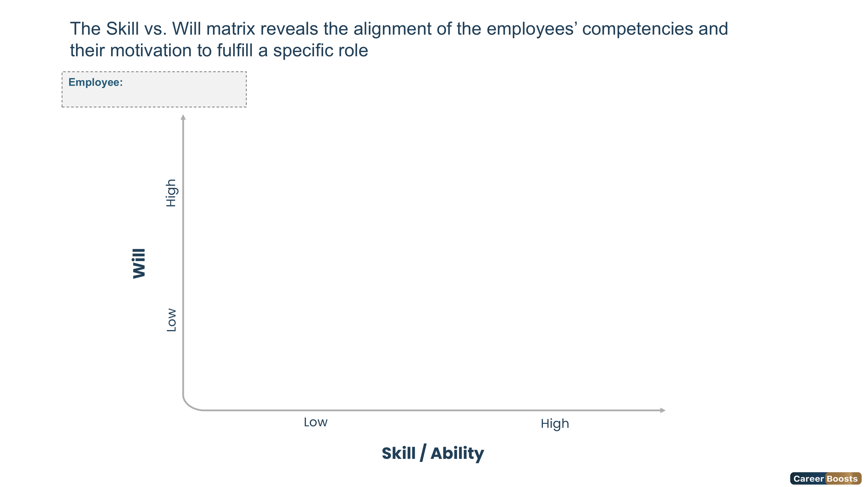


Ms. ahlem masouad
Low Skill / High Will
Guide
High Skill / High Will
Delegate
Low Skill / Low Will
Direct
High Skill / Low Will
Excite
19

Slide 20
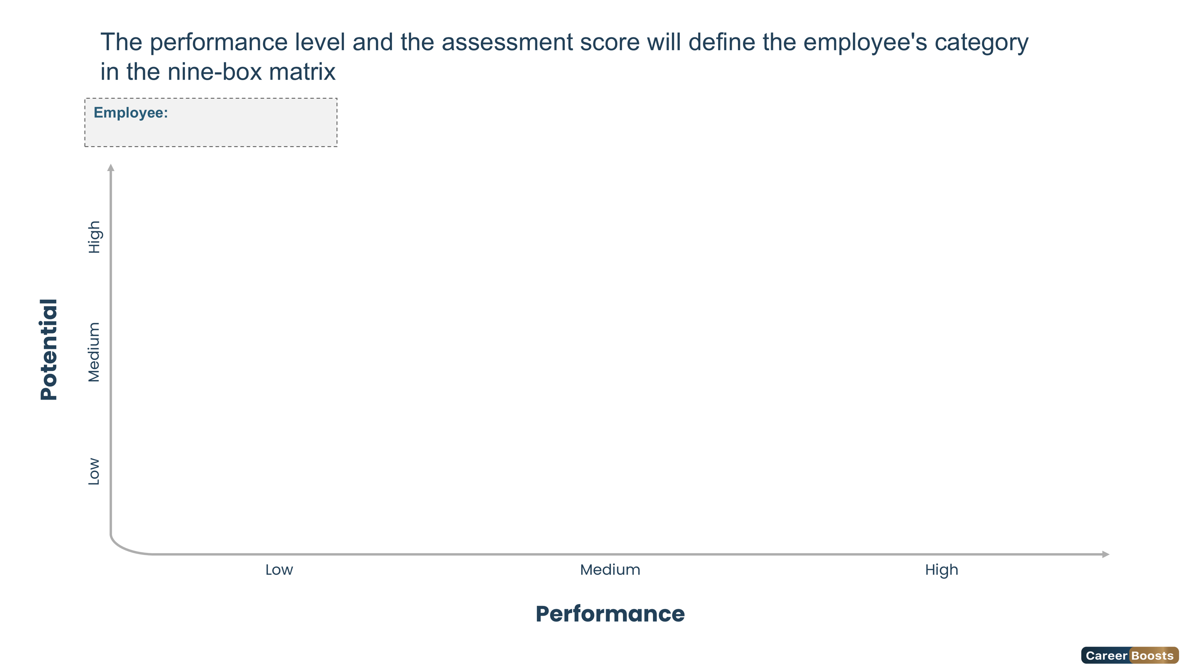


Ms. ahlem masouad
Long-Term Potential
Future Leader
Outstanding Leader
Marginal Contributor
Solid Contributor
Stretch Potential
Underperformer
Sound Contributor
Seasoned Professional
20

Slide 21
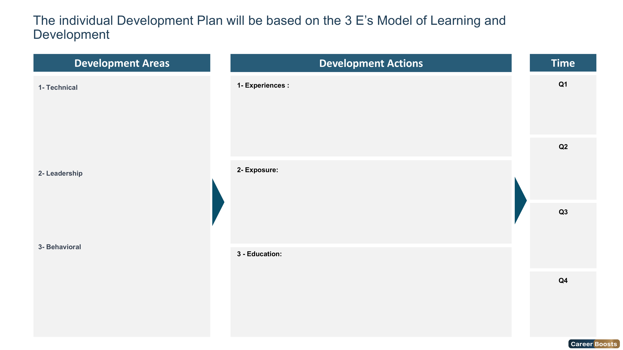
Stakeholders Management
Compensation and Benefits Management
Employee Relations Management
Talent Acquisition
Experience 1
Experience 2
Experience 3
1.1
2.1
3.1
3.2
1.2
3.2
3.3
2.2
Decision Making
Financial Acumen
Exposure 1
Exposure 2
Exposure 3
1.3
2.3
3.4
3.5
Behavioral for Business
Behavioral for Business2
Certified Information Security Manager
Certified Threat Intelligence Analyst
Certified in Risk and Information Systems Control (CRISC)
1.3
2.3
3.6
21

Slide 22
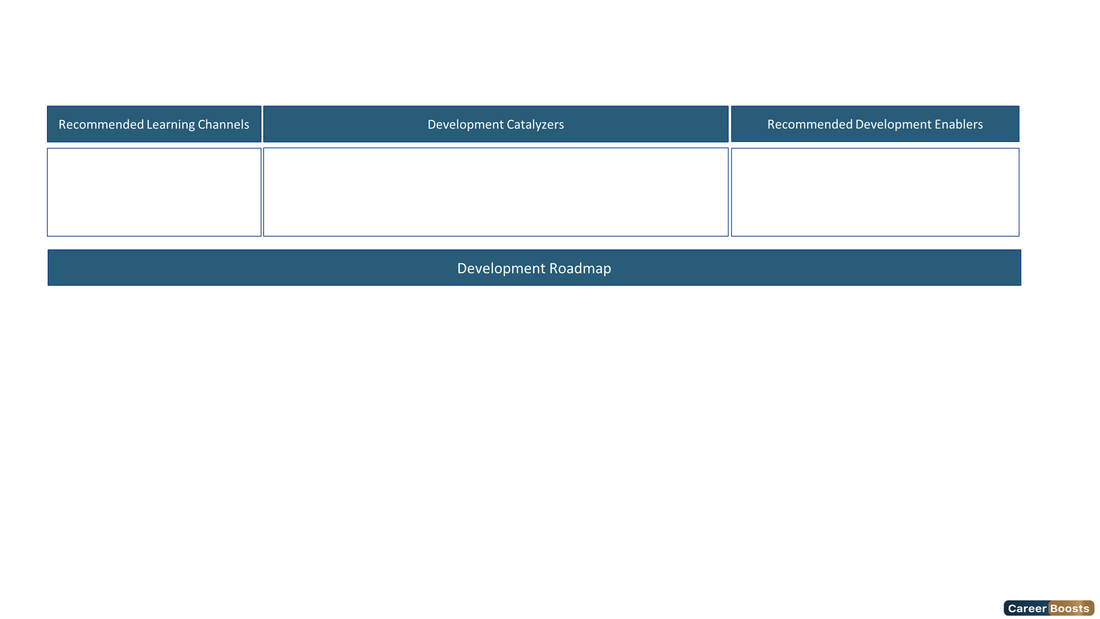
Based on the evaluation results, Ms. masouad will benefit from a development plan to reach the "Expert Level" of this role
In-class training
Online training
On the job training
Practical projects
A dedicated training budget
An alignment of the training with my self-interest
Defined career growth opportunities
Attending professional conferences
Leading a knowledge transfer initiative
Mentoring junior colleagues
Joining communities of practice (CoE)
Key Trainings | M1 | M2 | M3 | M4 | M5 | M6 | M7 | M8 | M9 | M10 | M11 | M12
Certified Information Security Manager | ★
Certified Threat Intelligence Analyst |  |  |  | ★
Certified in Risk and Information Systems Control (CRISC) |  |  |  |  | ★
22

Slide 23
